Slide 1
Adaptation of the Concept Hierarchy Model with Search Logs for Query Recommendation on Intranets
Date: 2012/12/13
Author: Ibrahim Adeyanju, Dawei Song , M-Dyaa Albakour,
Udo Kruschwitz , Anne De Roeck , Maria Fasli
Source: SIGIR "12
Advisor: Jia-ling, Koh
Speaker: Jiun Jia, Chiou

Slide 2
Outline
Introduction
Concept Hierarchy Model
Building SHReC Model
Query Recommender
Adaptive SHReC Model
Experiment
Conclusion

Slide 3
Introduction
user-friendly features
URL 1
URL 2
URL 3
URL 4
URL 5
URL 6
URL 7
URL 8
URL 9
URL 10
……..
Concept 1 | Concept 2 | Concept 3
URL1,2,7,8 | URL4.5 | URL10
Extra features are expected to make it easier and quicker for a user’s information need to be satisfied.
Generating suitable refinements(query recommendation) to a current (or an initial) query - interactive features in modern search engines.

Slide 4
Introduction
Recommendations
from the collection
discover relationships between terms based on statistical analysis
Give too many unsuitable suggestions for current queries that have a very high document frequency.
Recommendations
from the search logs
provide a conceptual view of the domain based on collective user intelligence
Not be able to give any suggestions for new queries that were never used in the past.

Slide 5
Introduction
The document collection on an Intranet is relatively small and changes less frequently. It is thus feasible to build a domain model to reflect the conceptual structure within the collection.
A concept hierarchy model generated from documents in an academic institution’s Intranet :
【Relationship】
lecturers | the courses they teach
research students | their supervisors
academic staff | their research interests
Idea:
Incorporating query refinements from search logs

Slide 6
Outline
Introduction
Concept Hierarchy Model
Building SHReC Model
Query Recommender
Adaptive SHReC Model
Experiment
Conclusion

Slide 7
Concept Hierarchy Model (Building Model)
A hierarchical tree ─ specialised concepts or terms are subsumed by more generic ones
Generated automatically using an unsupervised algorithm based on a statistical co-occurrence measure.
SHReC (Subsumption Hierarchy for Result Clustering)
Use term co-occurrence to create a subsumption hierarchical tree.
The generality or specificity of a term (or concept) in the model is determined mainly by its document frequency.
Term is the equivalent of a concept.
Notes:
The SHReC model is automatically derived as a hierarchical organization of concepts from a set of documents without using training data or standard clustering techniques.

Slide 8
A term ‘x’ is said to subsume ‘y’
α : the strength of subsumption
fruit
color
cola
orange
drink
pink
grapes
Document frequency:
df(color)> df(orange)
df(color^orange) / df(orange)=0.5
df(x) > df(y)
df(x ^ y) / df(y) ≥ α
color
(0.5)
Color
Pink
Drink
cola
df(color)=3
df(orange)=2
df(color^orange)=1
orange
Color
Fruit
Orange
fruit
color
drink
Cola
Fruit
grapes
orange
pink
cola
Fruit
grapes
Color
Orange
Notes:
α = 1 is ideal for a complete subsumption, a slightly smaller value can be chosen in order to allow few occurrences of term ‘y’ with other terms other than ‘x’.
α= 0:8 was chosen in based on empirical studies and we used the same value in the work.
Note:

Slide 9
Outline
Introduction
Concept Hierarchy Model
Building SHReC Model
Query Recommender
Adaptive SHReC Model
Experiment
Conclusion

Slide 10
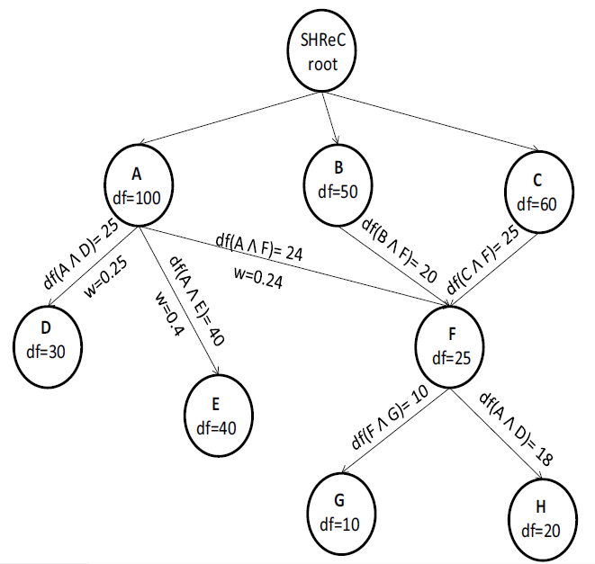
Concept Hierarchy Model (Query Recommender)
Immediate ancestor(Generalised):
A 、 B 、 C
Immediate descendants(Specialised):
G 、 H
Recommendation list:
H (18/25=0.9)
C (25/60=0.42)
G (10/25=0.4)
B (20/50=0.4)
A (24/100=0.24)

Slide 11
Outline
Introduction
Concept Hierarchy Model
Building SHReC Model
Query Recommender
Adaptive SHReC Model
Experiment
Conclusion

Slide 12
Adaptive SHReC Model
The adaptation process is carried out for pairs of query refinements found at periodic intervals (e.g. every week) to minimise its computational cost.
Starting with an initial SHReC model and then continuously update the model with the refinement terms found in the search logs.
totalFrequency is cumulative so that collective user intelligence is taken into account rather than those for just that periodic interval.
Notes:
Such refinements might be restricted to only those in which there was at least a click after refining the current query or all refinements found inthe logs for the adaptation period.

Slide 13
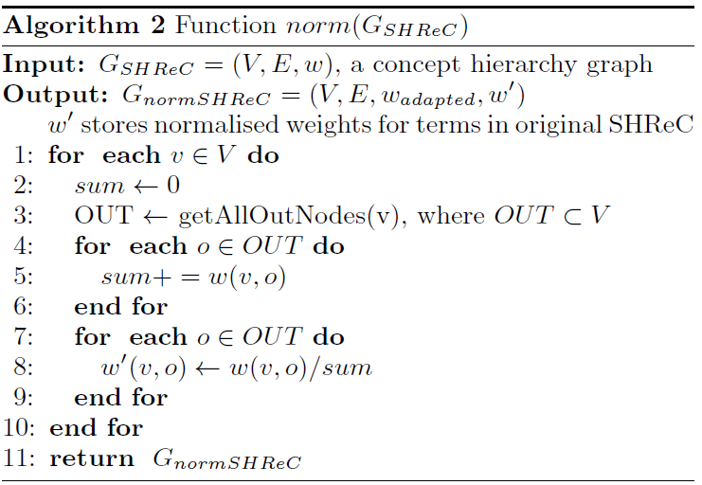
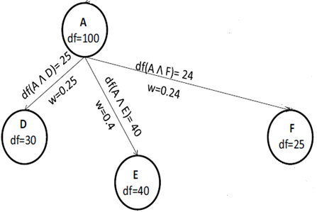
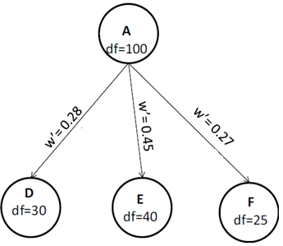
Normalisation of weights w for each edge in the initial SHReC built from the document collection only
A->D : $\frac{0.25}{0.25+0.4+0.24}$ =0.28
A->E : $\frac{0.4}{0.25+0.4+0.24}$ =0.45
A->F : $\frac{0.24}{0.25+0.4+0.24}$ =0.27

Slide 14
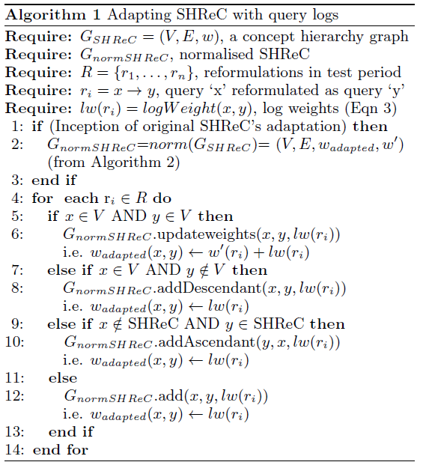
Basketball
Basketball rule
Basketball game
Basketball game nba
Basketball court
Basketball association
Condition 1
Condition 2
Condition 3

Slide 15
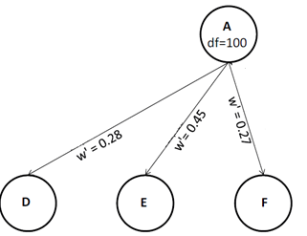
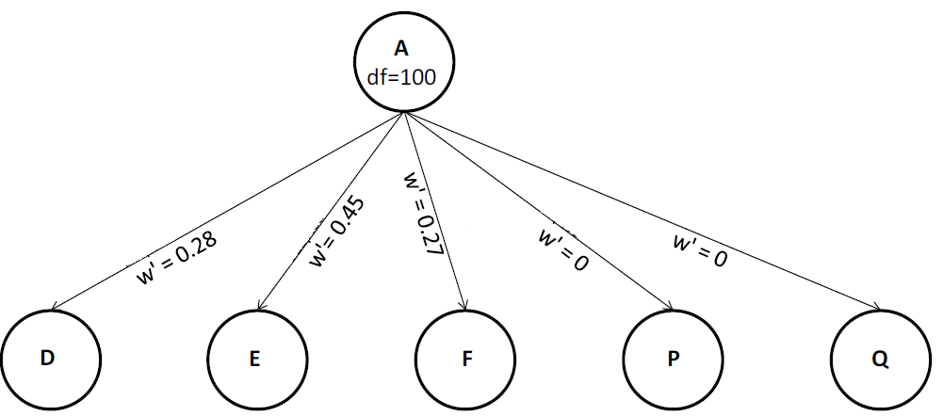
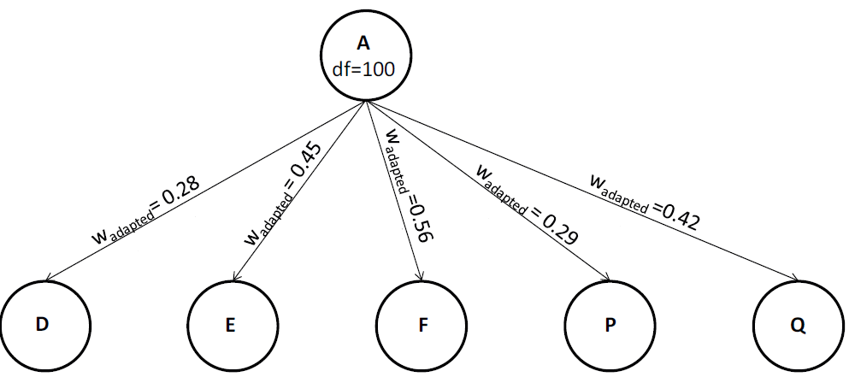
Condition 1
A --> D:
W_{adapted}=w’+lw(A,D)=0.28+0=0.28
A --> E:
W_{adapted}=w’+lw(A,E)=0.45+0=0.45
A --> F:
W_{adapted}=w’+lw(A,F)=0.27+0.29=0.56
A --> P:
W_{adapted}=lw(A,P)=0.29
Condition 2
A --> Q:
W_{adapted}=lw(A,Q)=0.42

Slide 16
Outline
Introduction
Concept Hierarchy Model
Building SHReC Model
Query Recommender
Adaptive SHReC Model
Experiment
Conclusion

Slide 17
Experiment
S_SHReC
A_SHReC
QFG
static SHReC
Built from only the Intranet document collection and is not updated in any form throughout the test period.
adaptive SHReC
Refinements extracted from search logs arecontinually incorporated at periodic intervals.
without click information
with click information
Query Flow Graph
Built continually at periodic intervals from the search logs.
Ranking only the immediate nodes coming out of a query node rather than all nodes in the graph.

Slide 18
Experiment
Datasets:
 | University of Essex | The Open University
Document collections | 77,841 | 220,059
Time | July 2011~October 2011
The document collections were created by crawling the main websites of the institutions with Nutch.
Obtain the document frequency of any term and co-occurrence document frequency of any two terms required for SHReC creation.

Slide 19
Comparison of different candidate sets for SHReC creation
Essex
OU

Slide 20
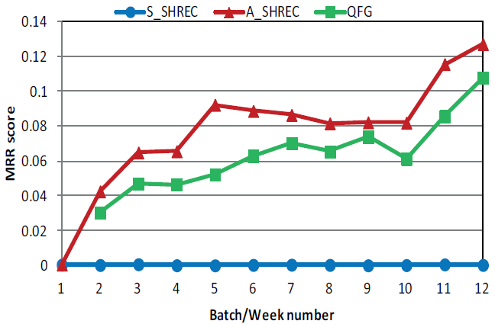
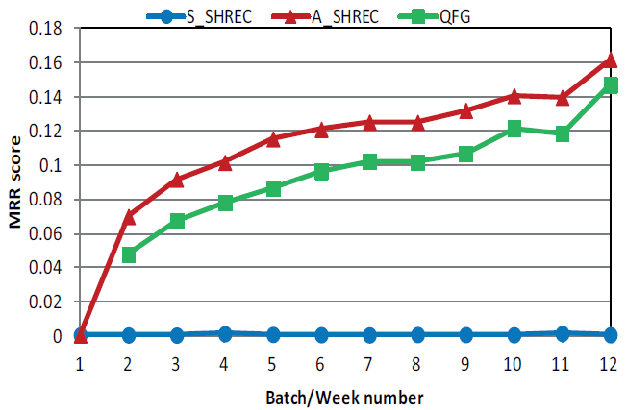
Experiment-1
Query | dog
doggy
dogs
doggie
doggy
dogs
doggie
doggy
dogs
doggie
Evaluation methodology
Mean Reciprocal Rank (MRR) score
Reciprocal rank | 1/2 | 1/3 | 1
MRR = $\frac{1/2+1/3+1}{3}$ = 0.61
Essex
OU
0.1272
0.1619
0.1078
0.1469
0.00042
0.00066
Notes:
Static SHReC (S SHReC) was significantly worse than adaptive SHReC and QFG. Its performance in proposing suitable query refinement terms is about the same with very little fluctuations every week throughout the evaluation for both Essex and OU. A possible reason for the low performance of S SHReC might be that the statistical
co-occurrence led to lots of noisy subsumptions between terms.

Slide 21
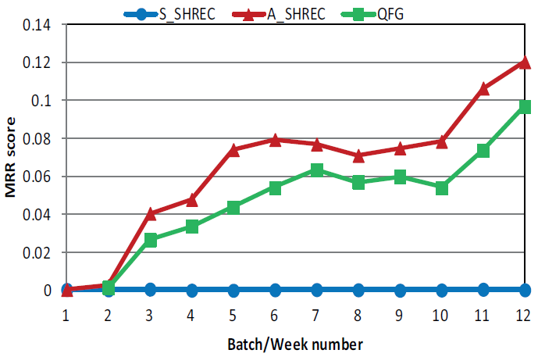
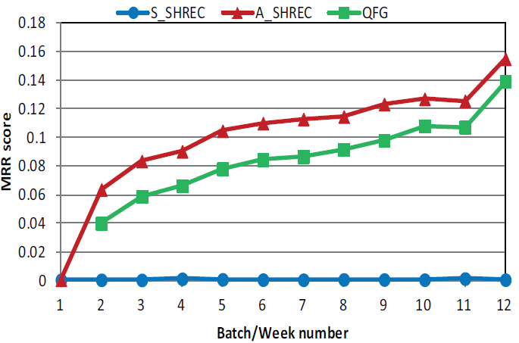
Incorporating Clicks for Adaptation
Essex
OU
0.1204
0.15474
0.0969
0.139
0.0004
0.00066
The evaluation scores for both A_SHReC and QFG when only log refinements with user clicks are used for adaptation are smaller than those for which all refinements in the logs are used.
Notes:
This implies that users will benefit more from the models when all log refinements are used for adaptation rather than only those with clicks.
※Users do not necessarily have to click on the resulting documents before modify their queries even though they might have read the result snippets or titles which give hints on how to better formulate their queries.

Slide 22
Experiment-2
Selected the worst performing 20 queries using the MRR_{C} quality metric.
For each of 20 queries,selected up to three recommendations from each recommender model(A_SHReC and QFG).
q : query r : recommendation
r_{i} : the rank of document clicked within the result
list displayed to the user

Slide 23
Query
❶
Recommendation
❶
❷
Rank
1
2
3
4
5
6
7
Rank
1
2
3
4
5
6
7
document
◻
◻
◻
◻
◻
◻
◻
◻
◻
◻
◻
◻
◻
◻
document
◻
◻
◻
◻
◻
◻
◻
◻
◻
◻
◻
◻
◻
◻
❶
MRR_{C}(q) = ($\frac{1}{2}$+$\frac{1}{3}$+$\frac{1}{5}$)/3 = 0.34
MRR_{C}(r) = (1+$\frac{1}{3}$+$\frac{1}{6}$)/3 = 0.5
∆ (MRR_{C})
= 0.5-0.34 = 0.16
❷
MRR_{C}(q) = (1+$\frac{1}{2}$+$\frac{1}{3}$)/3 = 0.61
MRR_{C}(r) = ($\frac{1}{4}$+$\frac{1}{5}$+$\frac{1}{6}$)/3 = 0.21
∆ (MRR_{C})
= 0.21-0.61 = -0.4

Slide 24
Outline
Introduction
Concept Hierarchy Model
Building SHReC Model
Query Recommender
Adaptive SHReC Model
Experiment
Conclusion

Slide 25
Conclusion
This paper proposed a novel method for adaptation of the concept hierarchy model with query refinements from search logs on Intranets for query refinement recommendation.
Experimental results indicate that adaptive model is significantly better than its static version and the state-of-the-art adaptive query recommender model.
It was better to adapt the concept hierarchy model with all log refinements irrespective of whether there were user clicks or not.

Slide 26
Thank you for
your attention !

